Slide 1





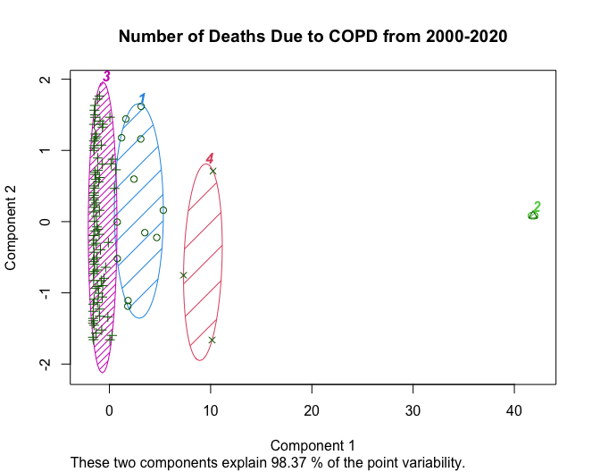
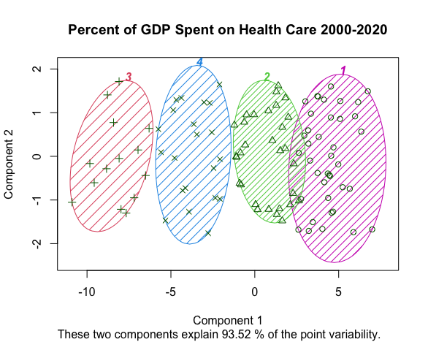
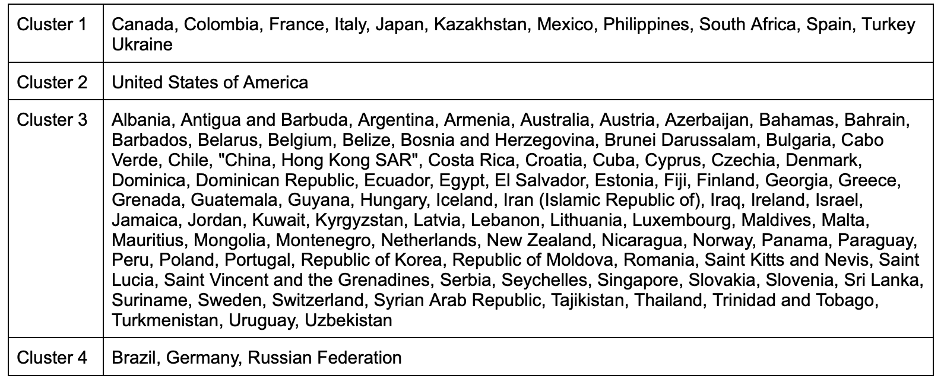
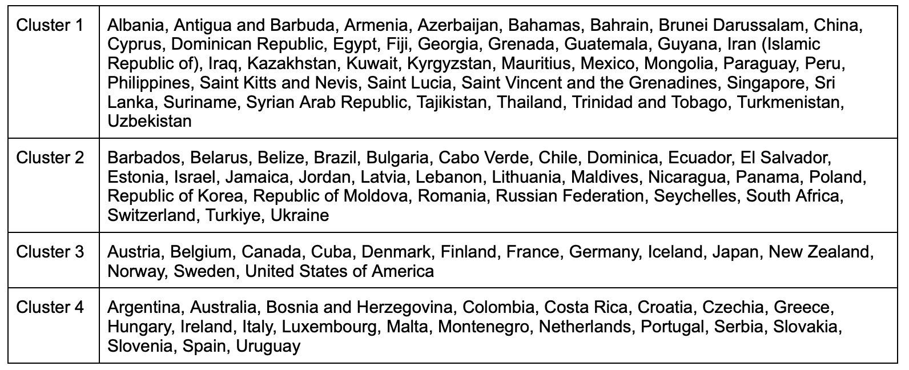
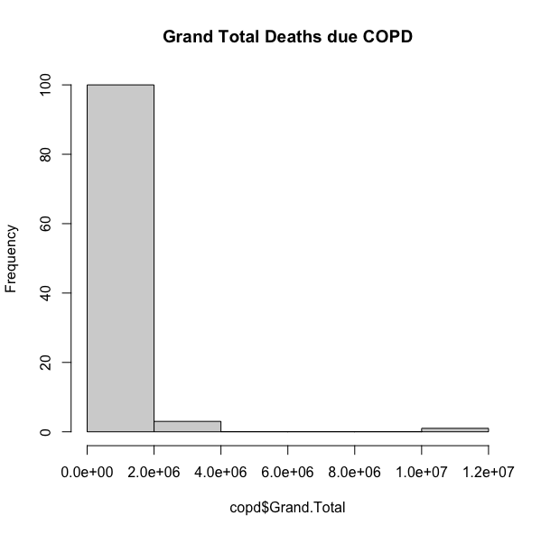
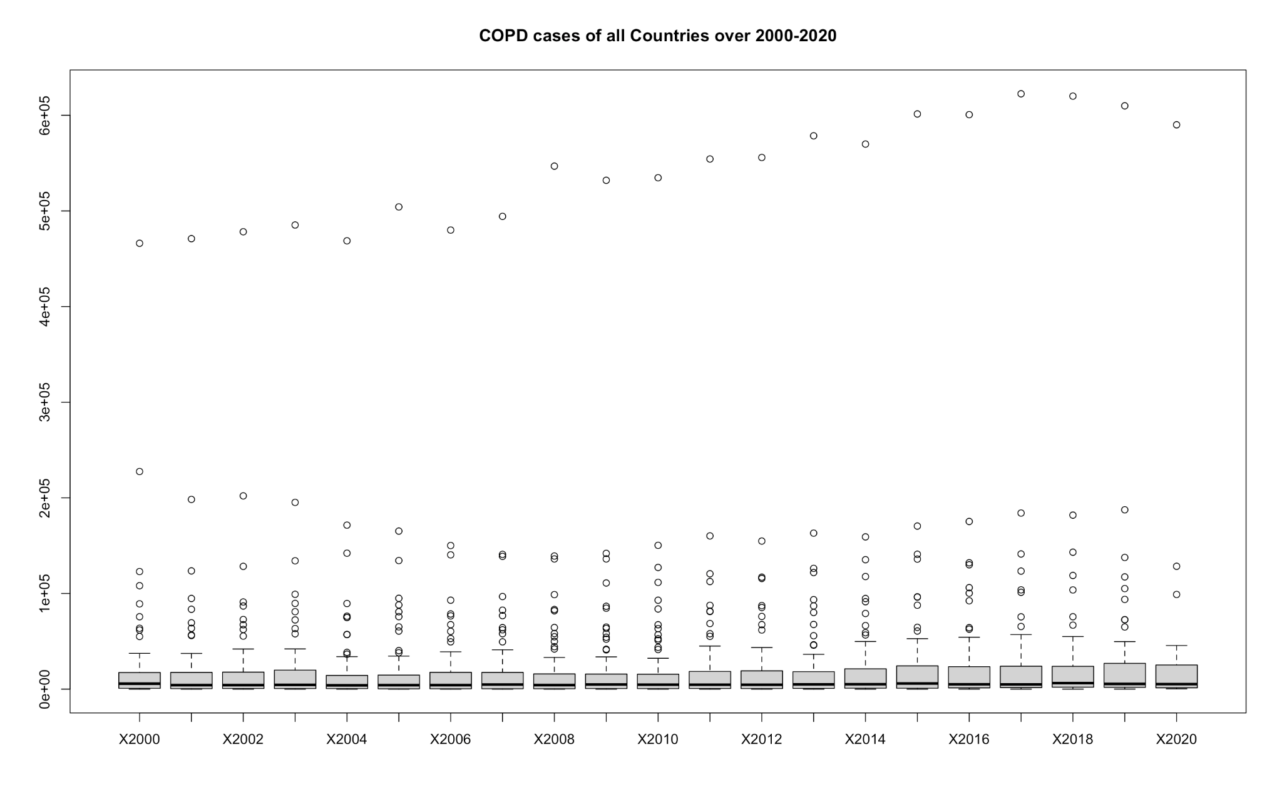
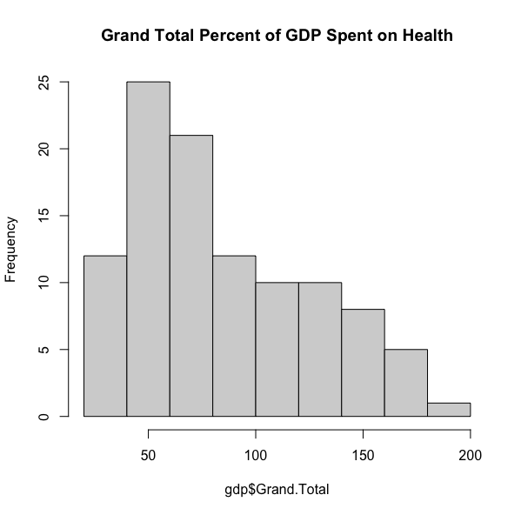
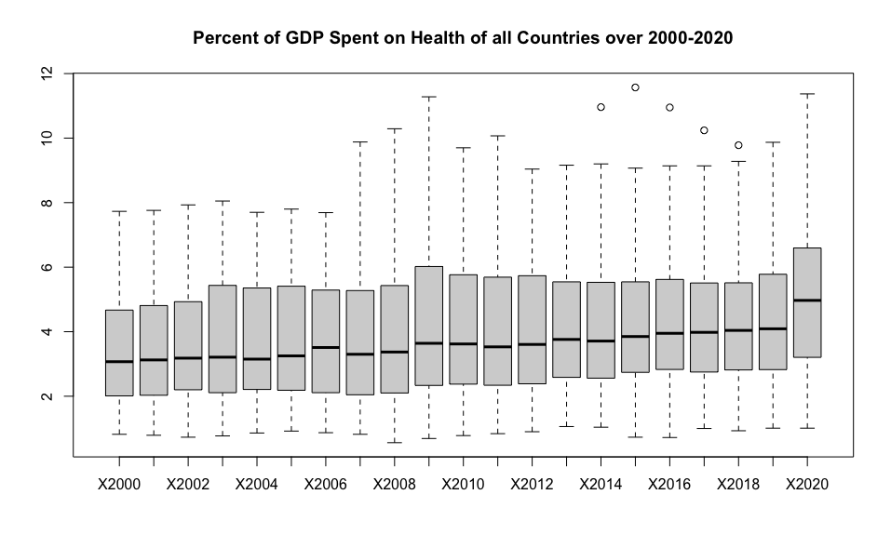
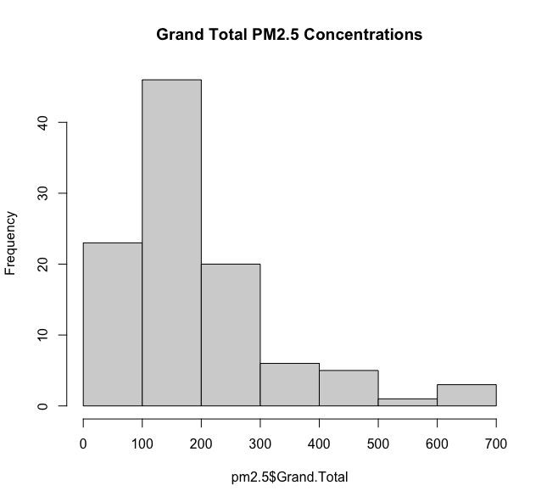
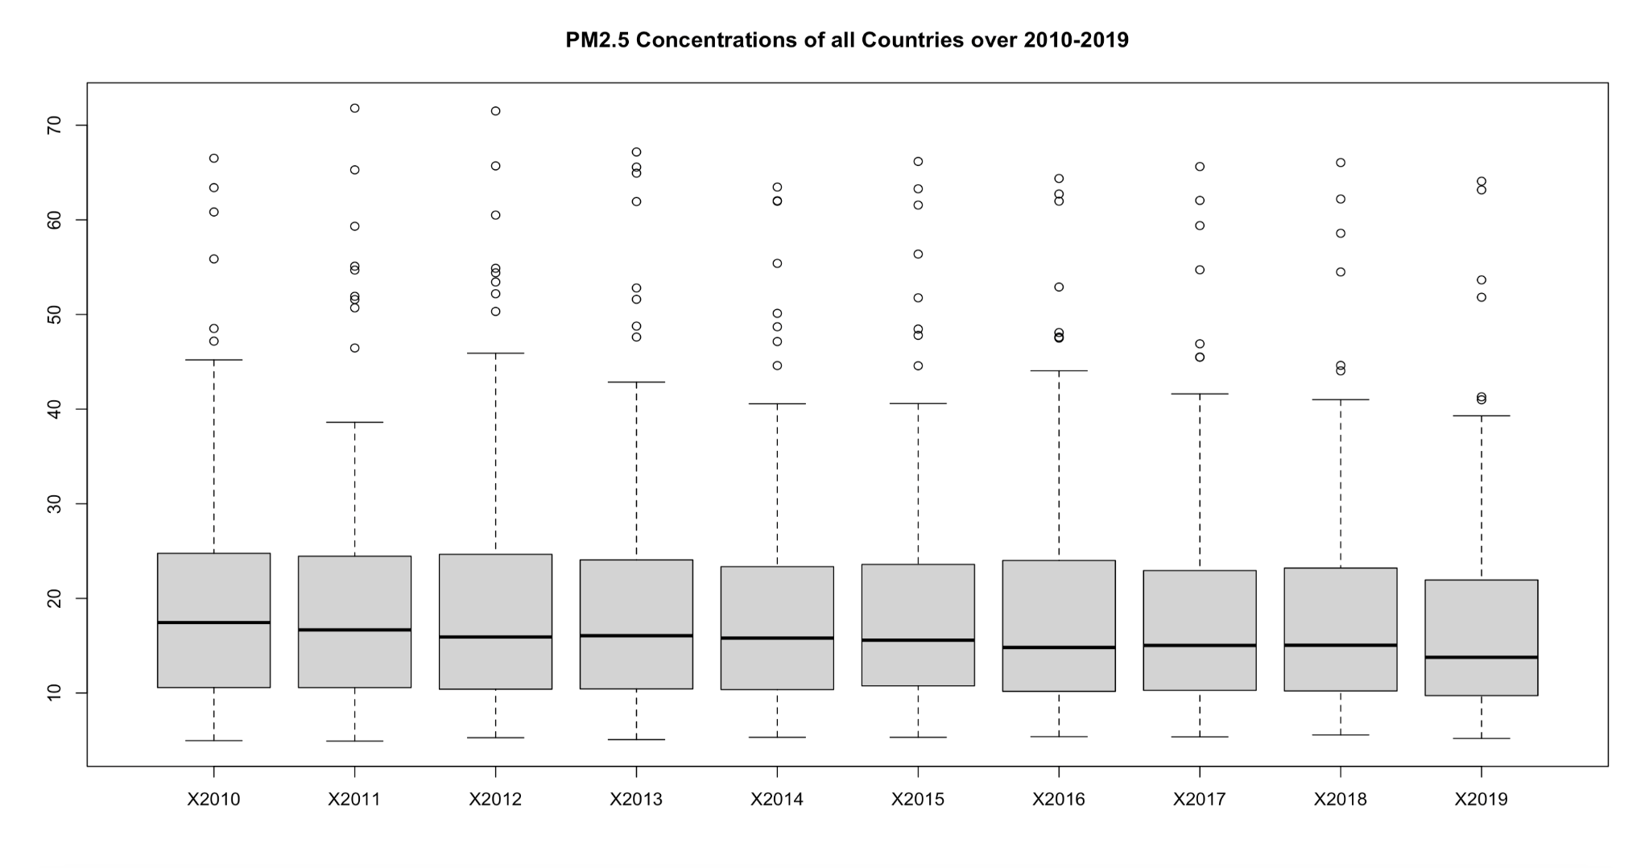
Analysis on Chronic Obstructive Pulmonary Disease Deaths, Percentage Spent on Health Care based on Gross Domestic Product (GDP), and Particulate Matter 2.5 Concentration Levels by Country
Keerti Sundaram ^{(sundak3@rpi.edu)}, (¹Rensselaer Polytechnic Institute 110 8th St., Troy, NY, 12180 United States)
Abstract
Model Development and Application
While there are many non-communicable diseases impacting countries today, one of the most prevalent is Chronic Obstructive Pulmonary Disease (COPD), which is the third leading cause of death worldwide (WHO). Chronic Obstructive Pulmonary Disease (COPD) refers to a group of diseases that cause airflow blockage and breathing-related problems. It is typically caused by long-term exposure to irritating gases or particulate matter such as particulate matter 2.5 (PM2.5). According to the World Health Organization, low- and middle-income countries are disproportionately affected by COPD, with nearly 90% of COPD deaths in those under 70 occurring in these countries. The goal of the following analysis is to determine whether government spending on healthcare and pollution levels contribute significantly to COPD deaths.
K-Means Clustering
K-Means Clustering was performed on both the COPD and GDP datasets. The goal of clustering was to determine which countries are grouped together for both datasets. To determine the value of k, elbow plots were used, these are omitted for space.
library(ISLR)
set.seed(101)
library(cluster)
#copd
totalClusters <- kmeans(copd_imp[-1], 4, nstart = 20)
clusplot(copd_imp,totalClusters$cluster, color = TRUE,
shade = TRUE, labels = 4, lines = 0, main = "Number of Deaths Due
to COPD from 2000-2020")
#gdp
totalClusters <- kmeans(gdp_imp[-1], 4, nstart = 20)
clusplot(gdp_imp,totalClusters$cluster, color = TRUE,
shade = TRUE, labels = 4, lines = 0, main = "Percent of GDP Spent on Health Care 2000-2020")
Hypotheses
Countries with a higher percent of GDP spent on health care will have lower COPD deaths.
Air pollution, quantified here by PM2.5, is also a contributing factor that accounts for an increased amount of COPD deaths despite a high percentage of GDP spent on health care.
Data Description
Utilized data from the World Health Organization on COPD deaths, percent of GDP spent on health, and PM2.5 Concentrations
Performed data imputation on the COPD and GDP datasets using
the VIM library and knn-imputation (COPD code shown below)
library(VIM)
#copd data
copd_imp <- kNN(copd[-length(copd)], k=5)
#removing extra imputation columns
copd_imp <- subset(copd_imp, select=Country:X2020)
#updating grand total column
grand_total <- rowSums(copd_imp[-1])
copd_imp$Grand.Total <- grand_total
Exploratory Data Analysis
COPD clusters
GDP clusters
2. Linear Regression
Linear regression was performed on countries that were grouped with different countries when comparing the COPD and GDP clusters. These countries were: Brazil, Canada, Colombia, France, Germany, Italy, Japan, Kazakhstan, Mexico, Philippines, Russian Federation, South Africa, Spain, Turkey, Ukraine, and United States of America. The goal of the regression analysis was to determine whether PM2.5 concentration levels have a significant relationship to COPD deaths. An example code snippet is shown below, only one country is shown, similar code was written for the other 15 countries.
df <- data.frame(t(pm2.5[pm2.5$Country == 'Brazil', ]),
t(copd[copd$Country == 'Brazil', ]))
colnames(df) <- c('pm2.5', 'copd')
df <- df[-1,]
df$pm2.5 <- as.numeric(df$pm2.5)
df$copd <- as.numeric(df$copd)
brazil_lm <- lm(copd ~ pm2.5, data = df)
summary(brazil_lm)
COPD histogram
b. COPD boxplot
The summary calls for each of the models revealed that there is a significant relationship between PM2.5 concentrations and deaths due to COPD when examining the data by country. Additionally, each of the 16 countries had a positive estimate coefficient for pm2.5, this means COPD has a positive increase when pm2.5 increases.
Conclusions
c. GDP histogram
d. GDP boxplot
Based on the above models, hypothesis 1 can not be proven or disproven. If hypothesis 1 was true, comparison of the clusters would reveal similar groupings of the countries. Although many countries are grouped similarly (except for the 16 used for the regression analysis), all four of the GDP clusters are split among the four COPD clusters (i.e. no GDP cluster is entirely contained in a COPD cluster). Additionally, the countries that are grouped similarly may be attributed to the fact that most countries are contained in one COPD cluster.
The regression analysis proved that there is a significant positive relationship between COPD deaths and PM2.5 concentrations. The 16 countries used for the regression analysis were also the countries with the 16 highest COPD deaths (when using the total number of deaths over 2000-2020). However, only 7 of these countries were in the top 20 for total amount spent on healthcare (i.e. sum of percent of GDP spent on healthcare over 2000-2020). Therefore, it is not necessarily true for these 16 countries that an increase in COPD deaths is due to lower spending on healthcare. However, PM2.5 concentrations have a significant relationship to COPD deaths but this does not prove that it is the only factor that accounts for differences between the clusters of the data sets. In the future, it would be worthwhile to perform the regression analysis utilizing all of the countries in the data set.
e. PM2.5 Histogram
f. PM2.5 Boxplot
References
“Chronic Obstructive Pulmonary Disease (COPD).” Centers for Disease Control and Prevention, Centers for Disease Control and Prevention, 8 Apr. 2022, https://www.cdc.gov/copd/index.html.
“Chronic Obstructive Pulmonary Disease (COPD).” World Health Organization, World Health Organization, 16 Mar. 2023, https://www.who.int/news-room/fact-sheets/detail/chronic-obstructive-pulmonary-disease-(copd).
“COPD.” Mayo Clinic, Mayo Foundation for Medical Education and Research, 15 Apr. 2020, https://www.mayoclinic.org/diseases-conditions/copd/symptoms-causes/syc-20353679.
“Fine Particles (PM 2.5) Questions and Answers.” New York State Department of Health, Feb. 2018, https://www.health.ny.gov/environmental/indoors/air/pmq_a.htm.
“Health Financing.” World Health Organization, World Health Organization, https://www.who.int/health-topics/health-financing#tab=tab_1.
Hosseinpoor, Ahmad Reza, et al. “Promoting Health Equity: Who Health Inequality Monitoring at Global and National Levels.” Global Health Action, vol. 8, no. 1, 18 Sept. 2015, p. 29034.,
https://doi.org/10.3402/gha.v8.29034.
Kowarik, Alexander, and Statistik Austria. “K-Nearest Neighbour Imputation.” R Documentation, https://search.r-project.org/CRAN/refmans/VIM/html/kNN.html.
Kassambara, Alboukadel. “K-Means Clustering in R: Algorithm and Practical Examples.” Datanovia, 21 Oct. 2018, https://www.datanovia.com/en/lessons/k-means-clustering-in-r-algorith-and-practical-examples/.
Wen, Chi Pang, and Wayne Gao. “PM 2·5 : An Important Cause for Chronic Obstructive Pulmonary Disease?” The Lancet Planetary Health, vol. 2, no. 3, Mar. 2018, https://doi.org/10.1016/s2542-5196(18)30025-1.
Plot Descriptions:
Histogram of countries’ total deaths due to COPD
Boxplots of countries’ deaths due to COPD by year
Histogram of countries’ total percent of GDP spent on health care
Boxplots of countries’ percent of GDP spent on health by year
Histogram of countries’ total concentration levels of PM2.5
Boxplots of countries’ concentration levels of PM2.5 by year
Notes:
Plot descriptions

